Slide 1
Hotel Bookings Analysis
Submitted By : Haneesha Thasni N
Date: 25/04/2025

Slide 2
Welcome to our data-driven deep dive into hotel bookings!
This project uncovers powerful insights hidden within hotel booking data to reveal trends, boost revenue, and reduce cancellations. By analyzing booking behaviors, evaluating distribution channel performance, and identifying key influencers, our goal is to empower smarter decisions that enhance operational efficiency, elevate the guest experience, and drive profitability. Get ready to explore actionable strategies backed by data that will help turn challenges into opportunities in the hospitality space.

Slide 3
Data Overview
Total Records = 17 columns, 119390 rows
No Duplicate Rows
Null Value occur in 1 column( Country)
Booking ID: Unique identifier assigned to each booking
Hotel: Property type where the booking was made
Booking Date: Date when the reservation was created
Arrival Date: Scheduled check-in date
Lead Time: Number of days between booking and arrival date
Nights: Duration of the stay in nights
Guests: Number of guests included in the booking
Distribution Channel: Source of booking (Direct, Travel Agent, Corporate, etc.)
Customer Type: Classification of customers (Transient, Group, etc.)
Country: Country of origin of the guest
Deposit Type: Deposit payment status (No Deposit, Non-Refundable, etc.)
Average Daily Rate (ADR): Average price per night charged for the booking
Status: Current status of the booking (Check-Out, Cancelled, etc.)
Status Update: Date when the booking status was last modified
Cancelled (0/1): Indicator denoting whether the booking was cancelled
Revenue: Actual revenue generated from completed bookings
Revenue Loss: Estimated revenue loss due to cancellations

Slide 4
Objectives
Detect Cancellation Triggers Identify what drives booking cancellations and develop proactive strategies to minimize them.
Unlock Customer Value Analyze revenue across segments to spotlight the most profitable customer profiles.
Power Up Pricing Optimize pricing by understanding how lead time, seasonality, and ADR interact.
Maximize Channel Performance Evaluate distribution channels to focus on the most revenue-generating sources.

Slide 5
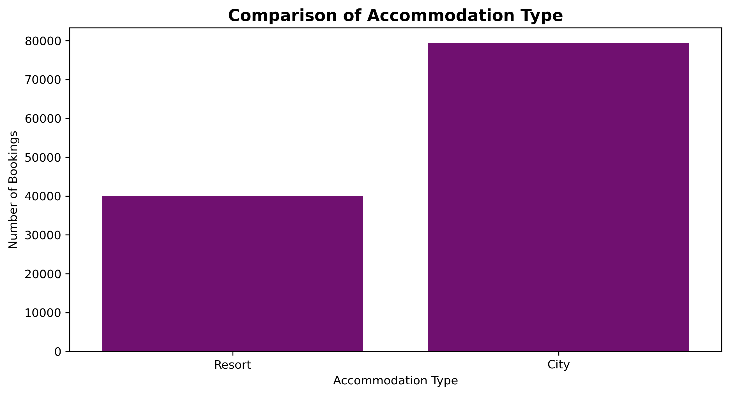
Accommodation Showdown
More guests prefer city over resorts

Slide 6
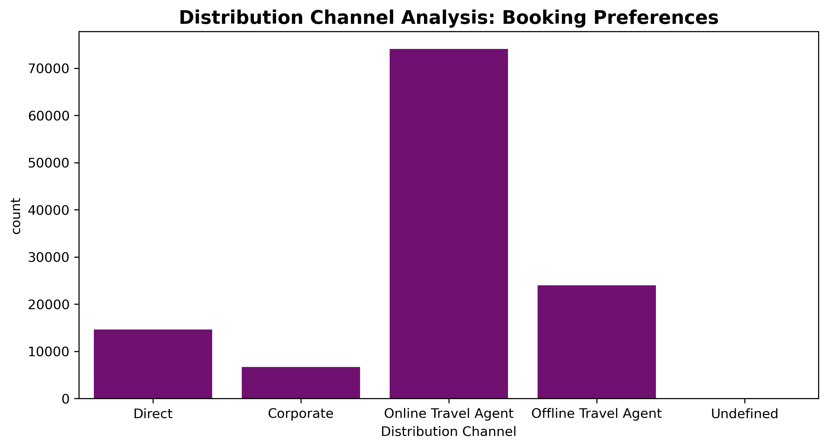
Booking Channel Breakdown
Digital platforms lead in bookings, while corporate channels lag.

Slide 7
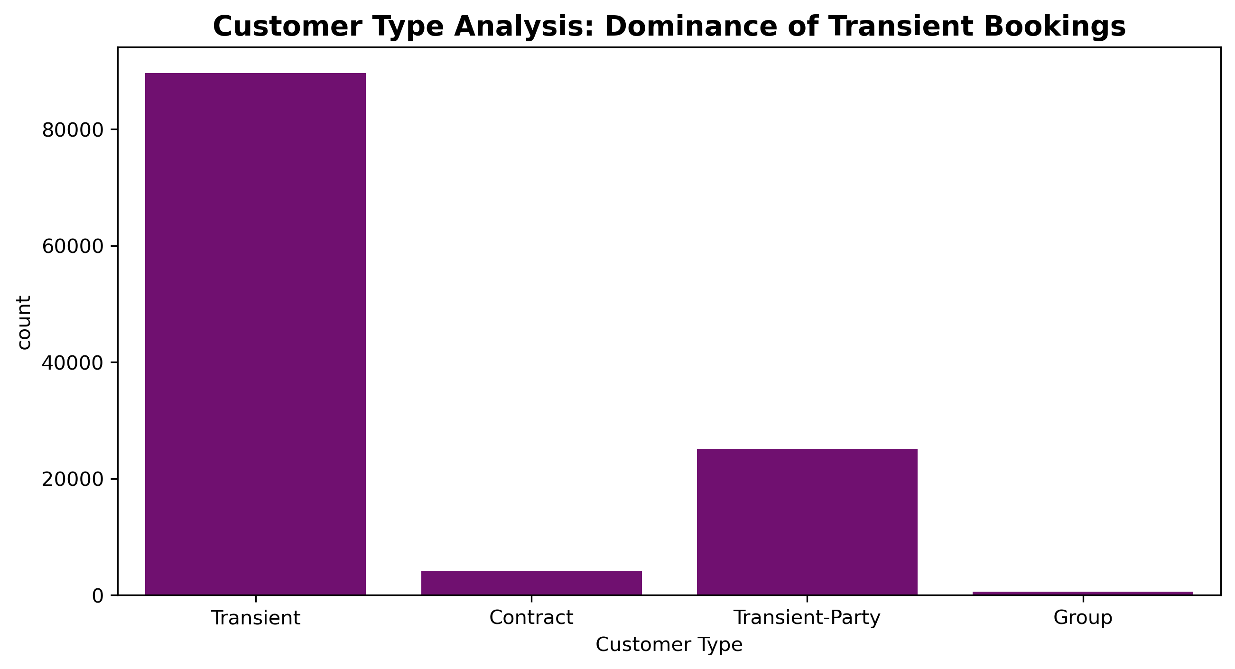
Customer Type Breakdown
Transient stays dominate; group bookings are minimal.

Slide 8
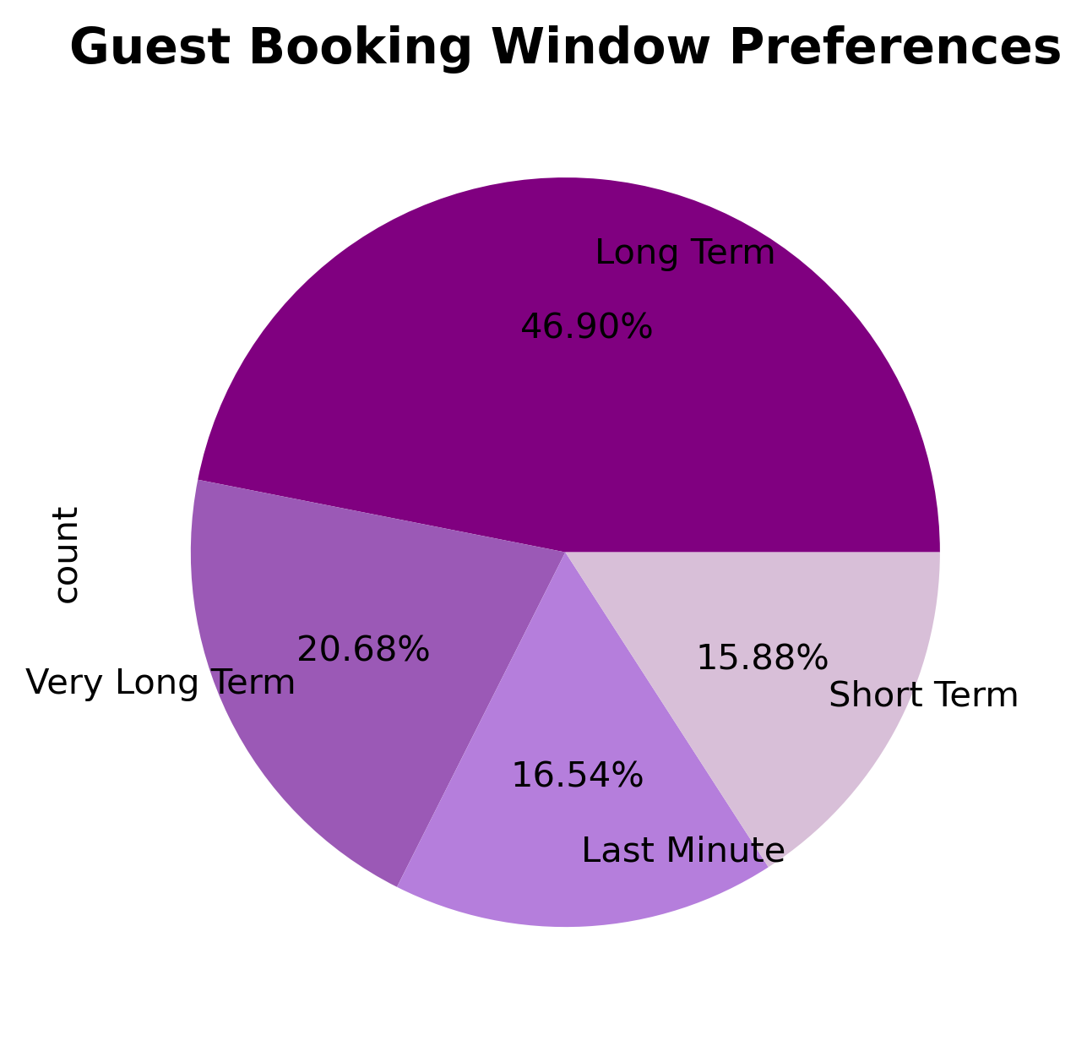
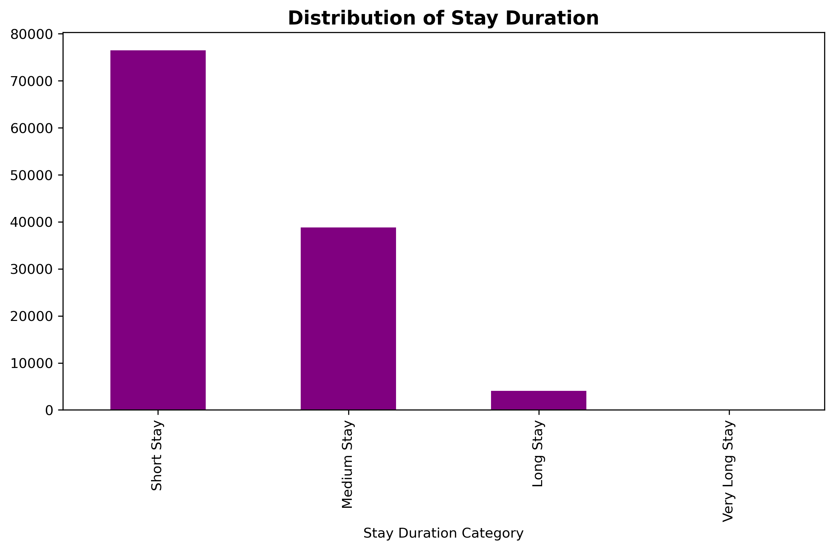
Booking Timing & Stay Duration Trends
Most guests plan their stays well in advance and prefer short visits over extended stays.

Slide 9
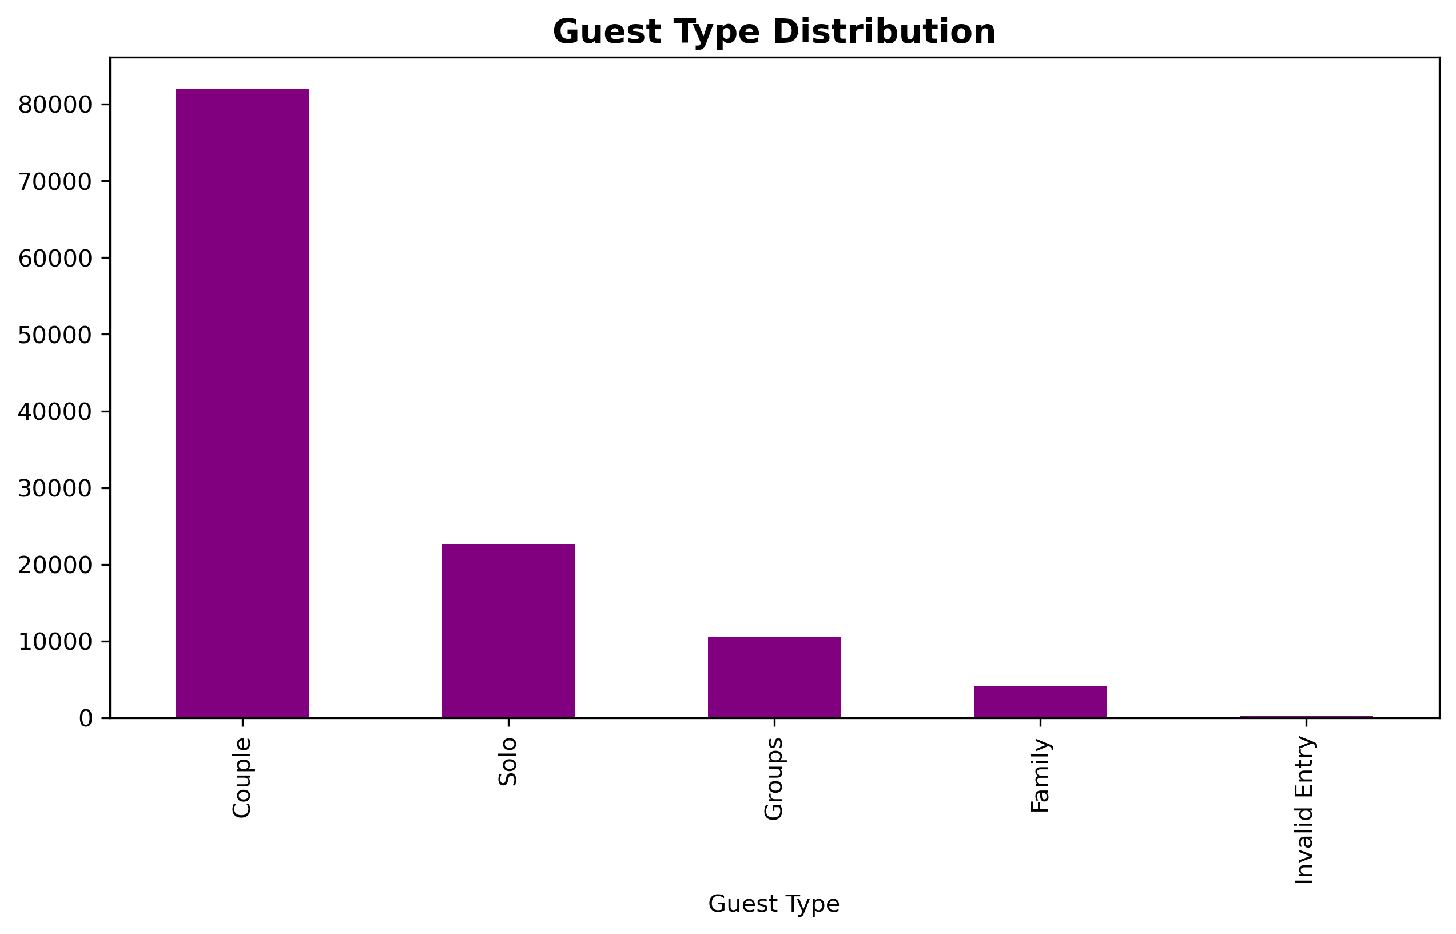
Guest Type Breakdown
Most guests were couples on leisure trips, and all were first-time visitors, showing a chance to improve loyalty.

Slide 10
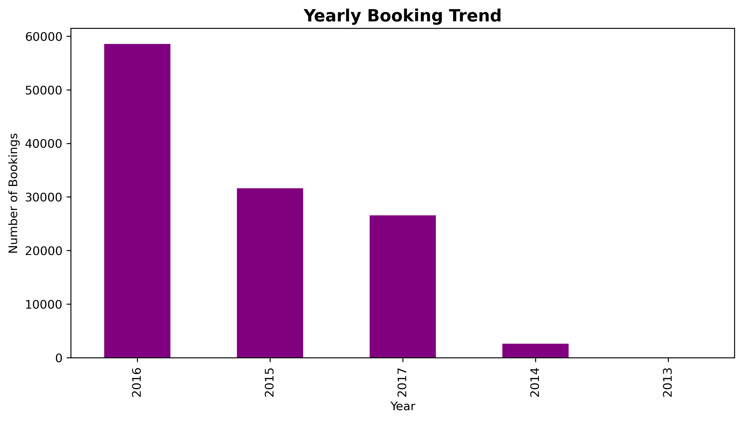
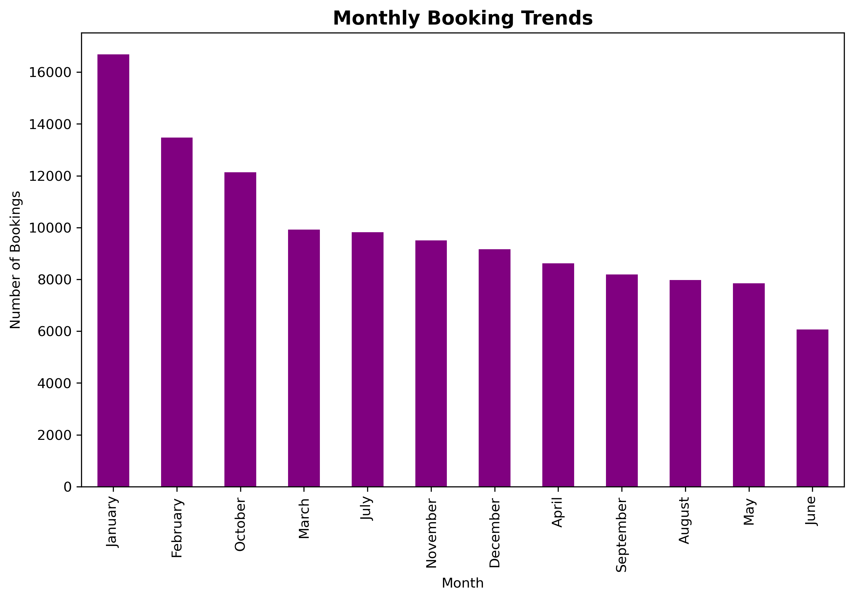
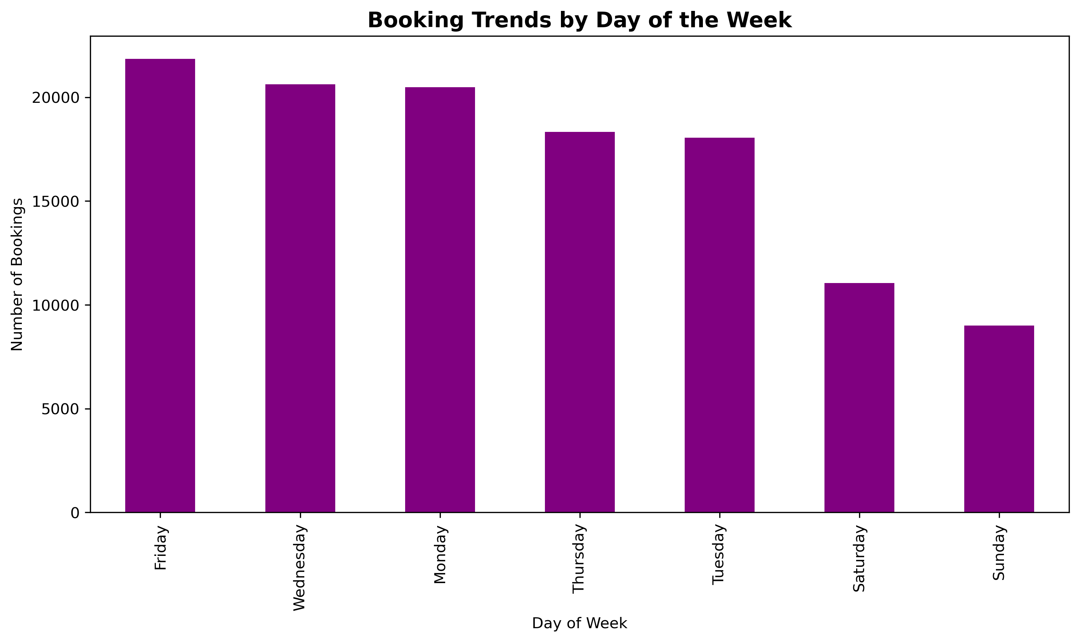
Trends Over Time by Bookings
Most bookings happened in 2016, mainly in January and February, with Fridays being the most popular, showing growth, seasonality, and weekday preference.

Slide 11
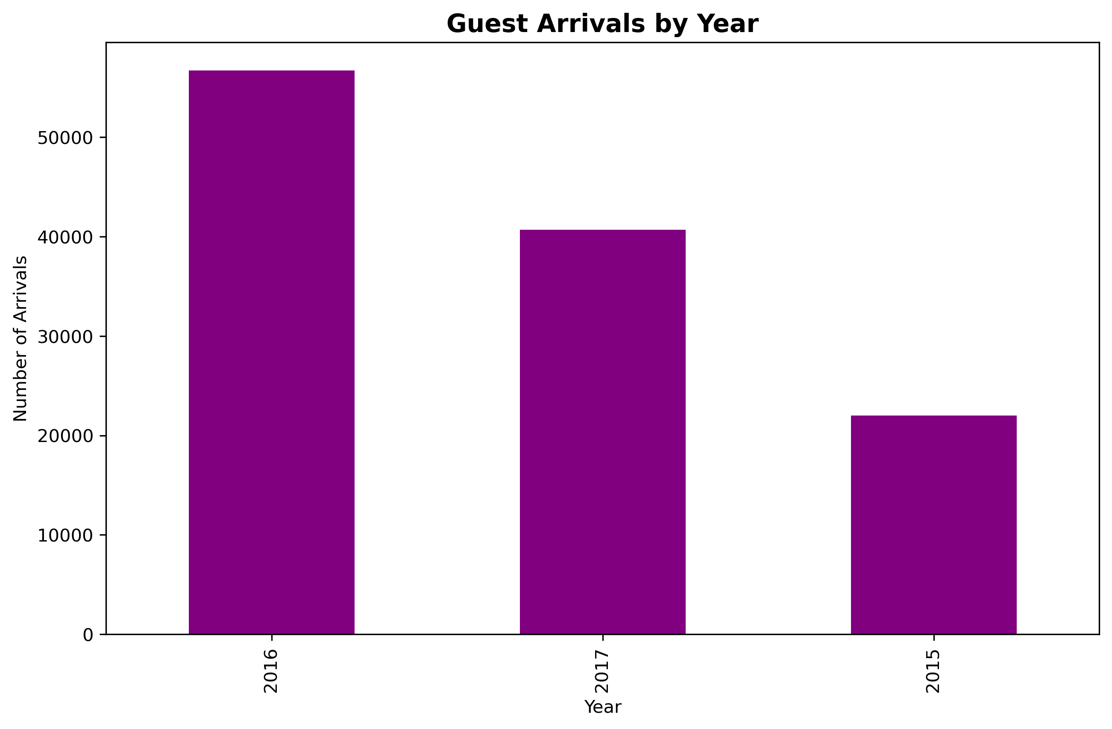
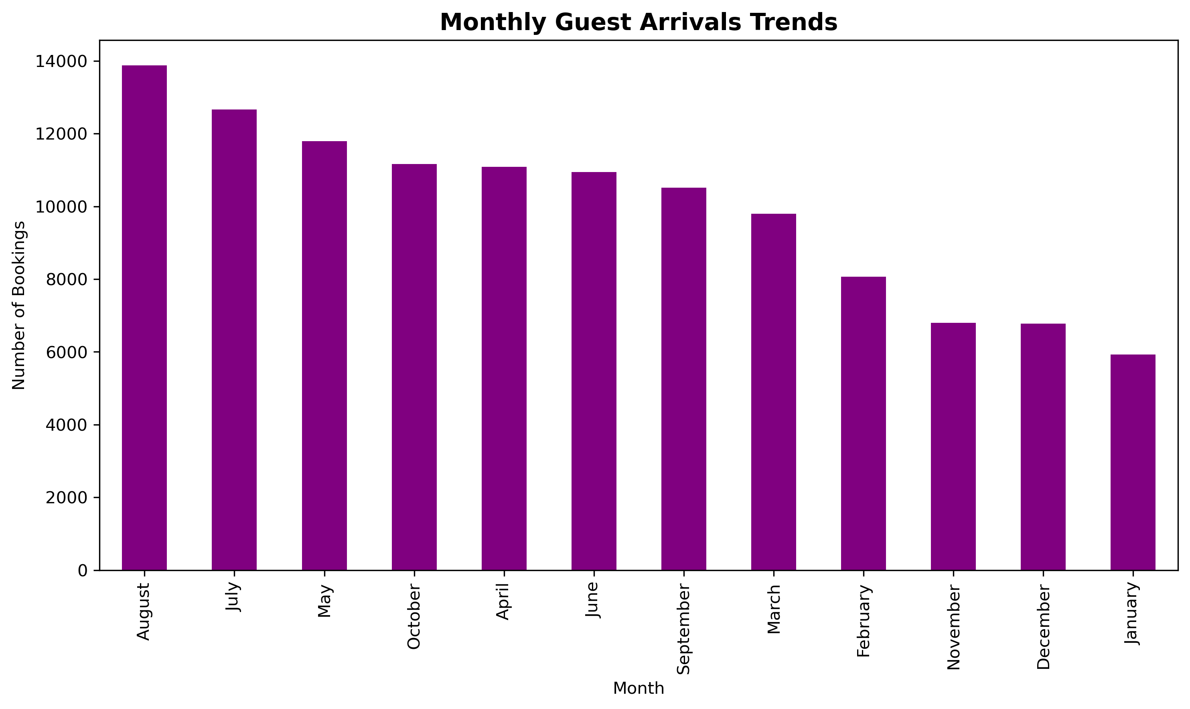
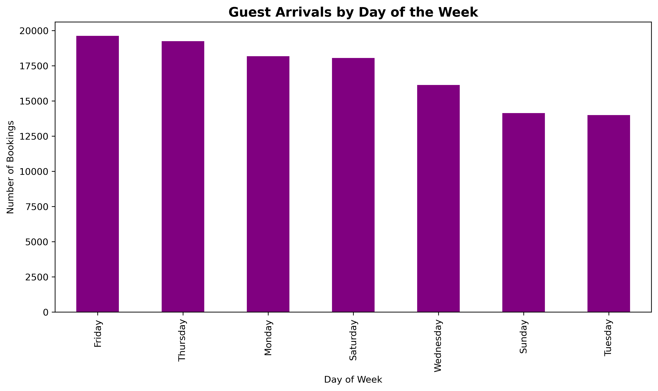
Trends Over Time by Arrivals
Guest arrivals peaked in 2016, especially during summer months like August and July, with most check-ins on Fridays and Thursdays, showing growth, seasonality, and end-of-week preference.

Slide 12
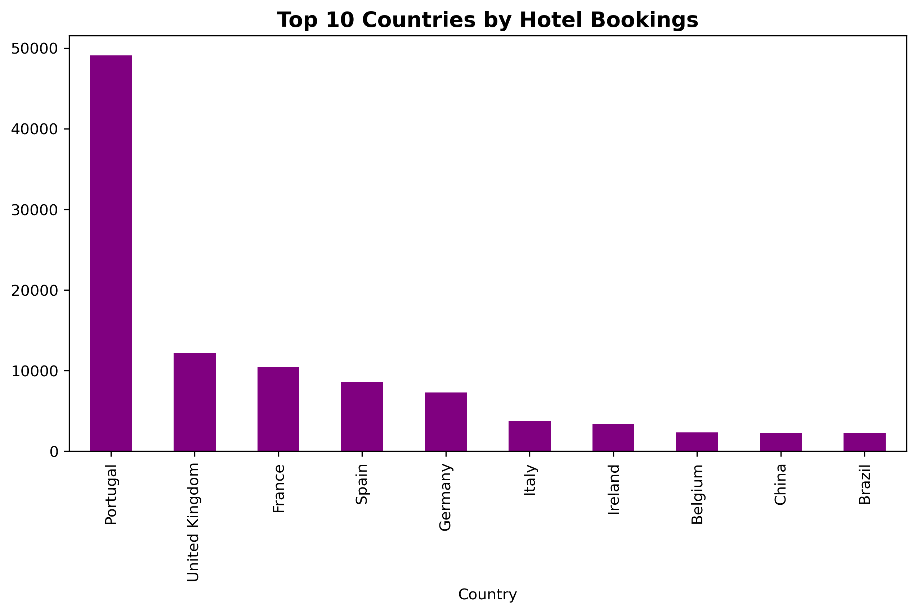
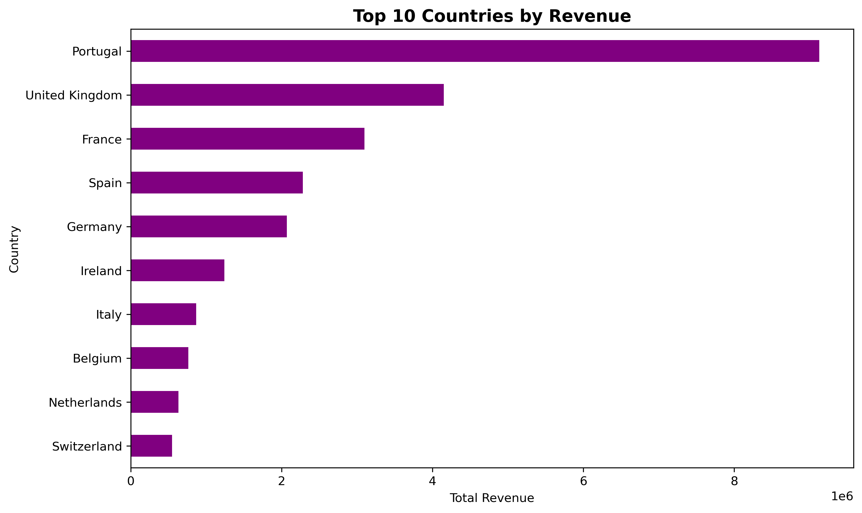
Top 10 Countries
Portugal leads in bookings and revenue, followed by the UK and France, reflecting strong domestic and European tourism demand.

Slide 13
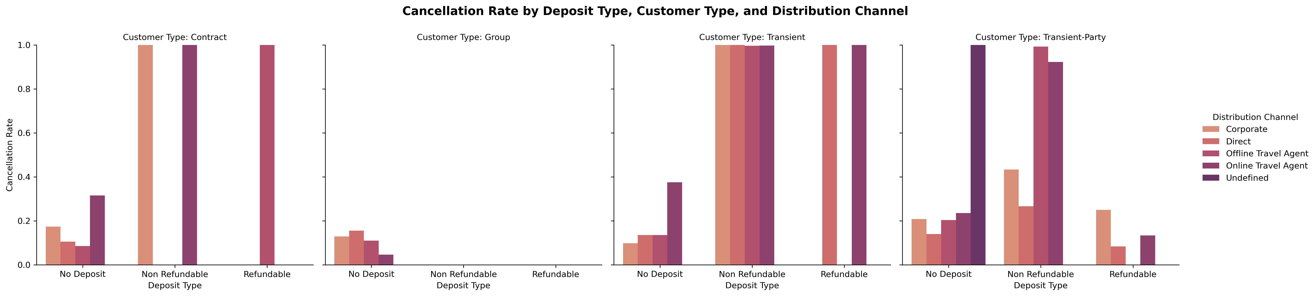
Cancellation Rate by Segment
Cancellations are most common for 'No Deposit' bookings, especially among transient customers and online travel agents.

Slide 14
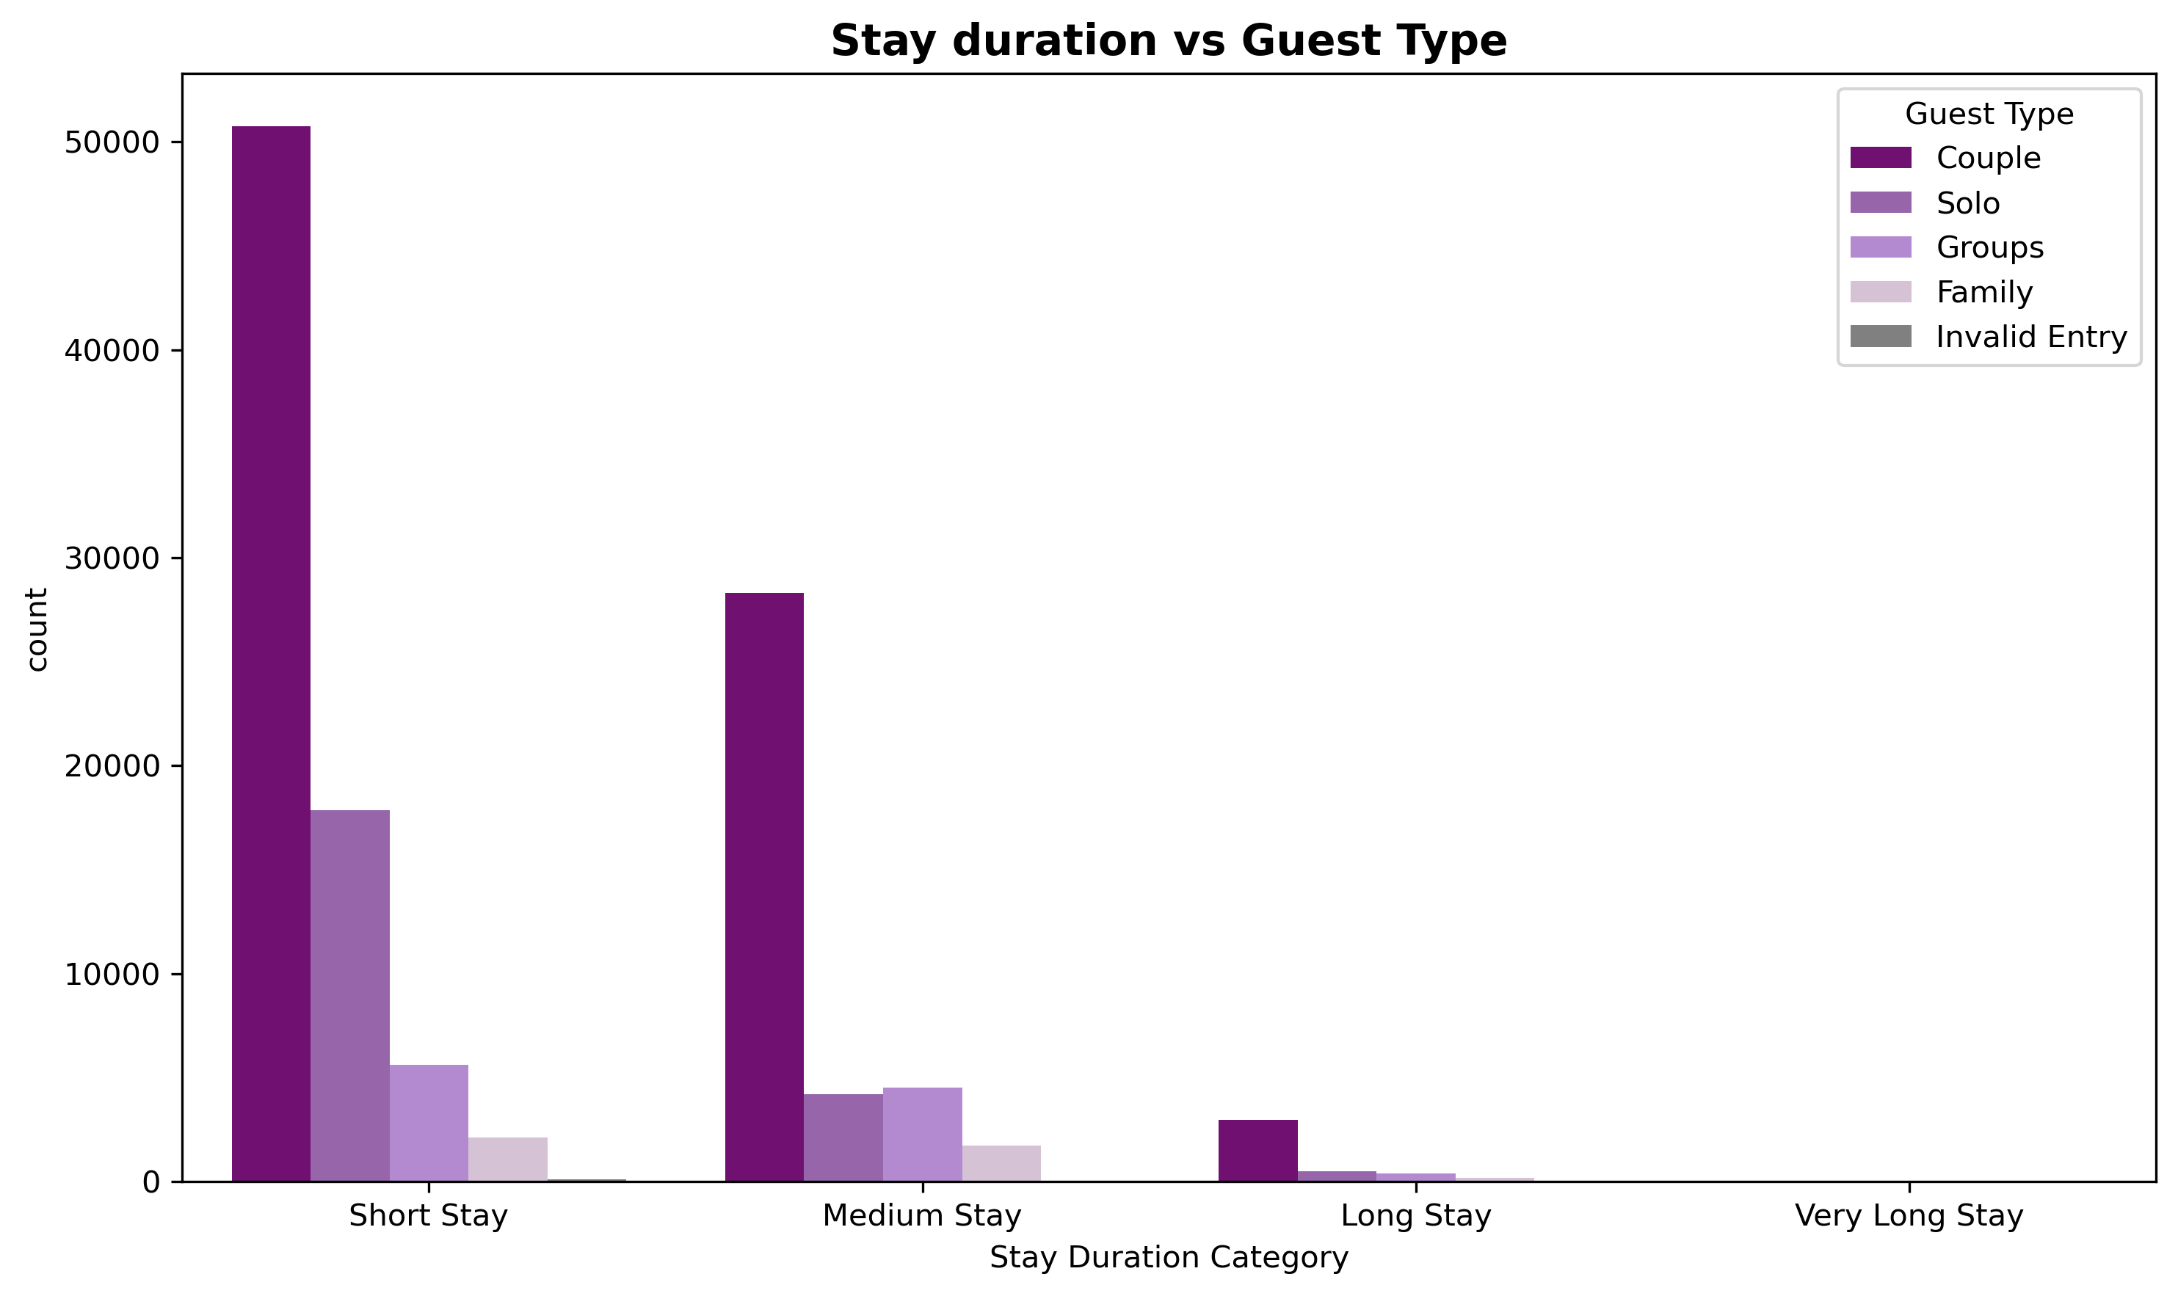
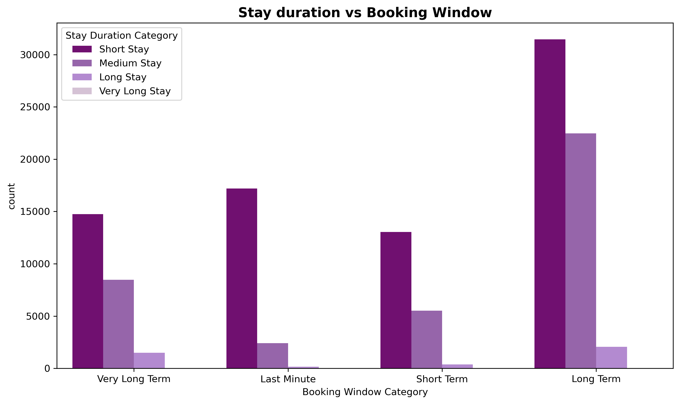
Stay Trends by Guest Type & Booking Window
Short stays are most popular, especially among couples and solo guests, and this trend persists across all booking windows.

Slide 15
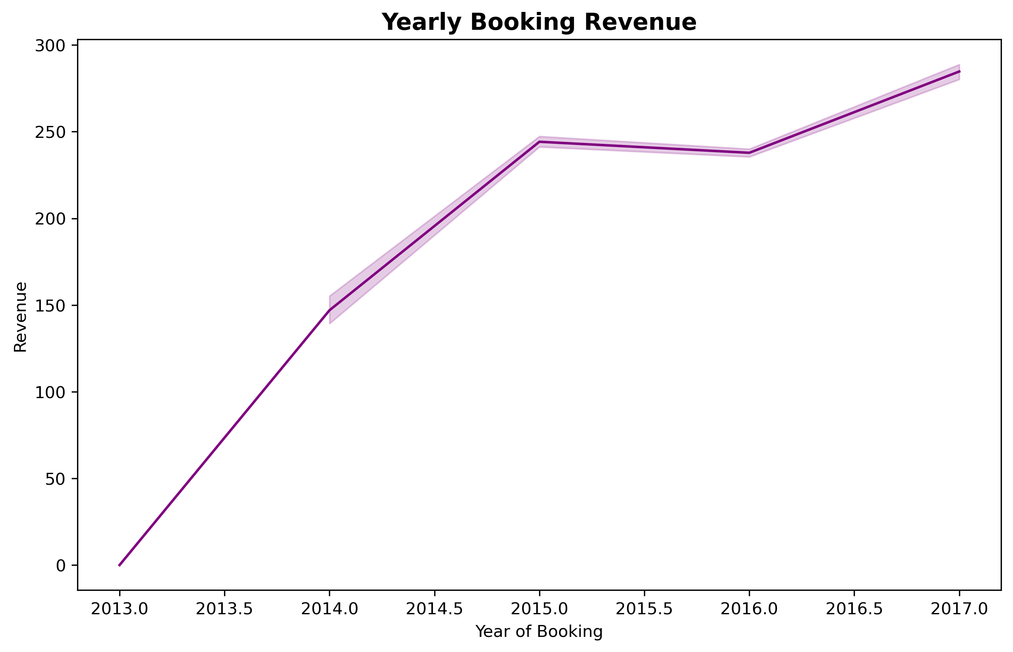
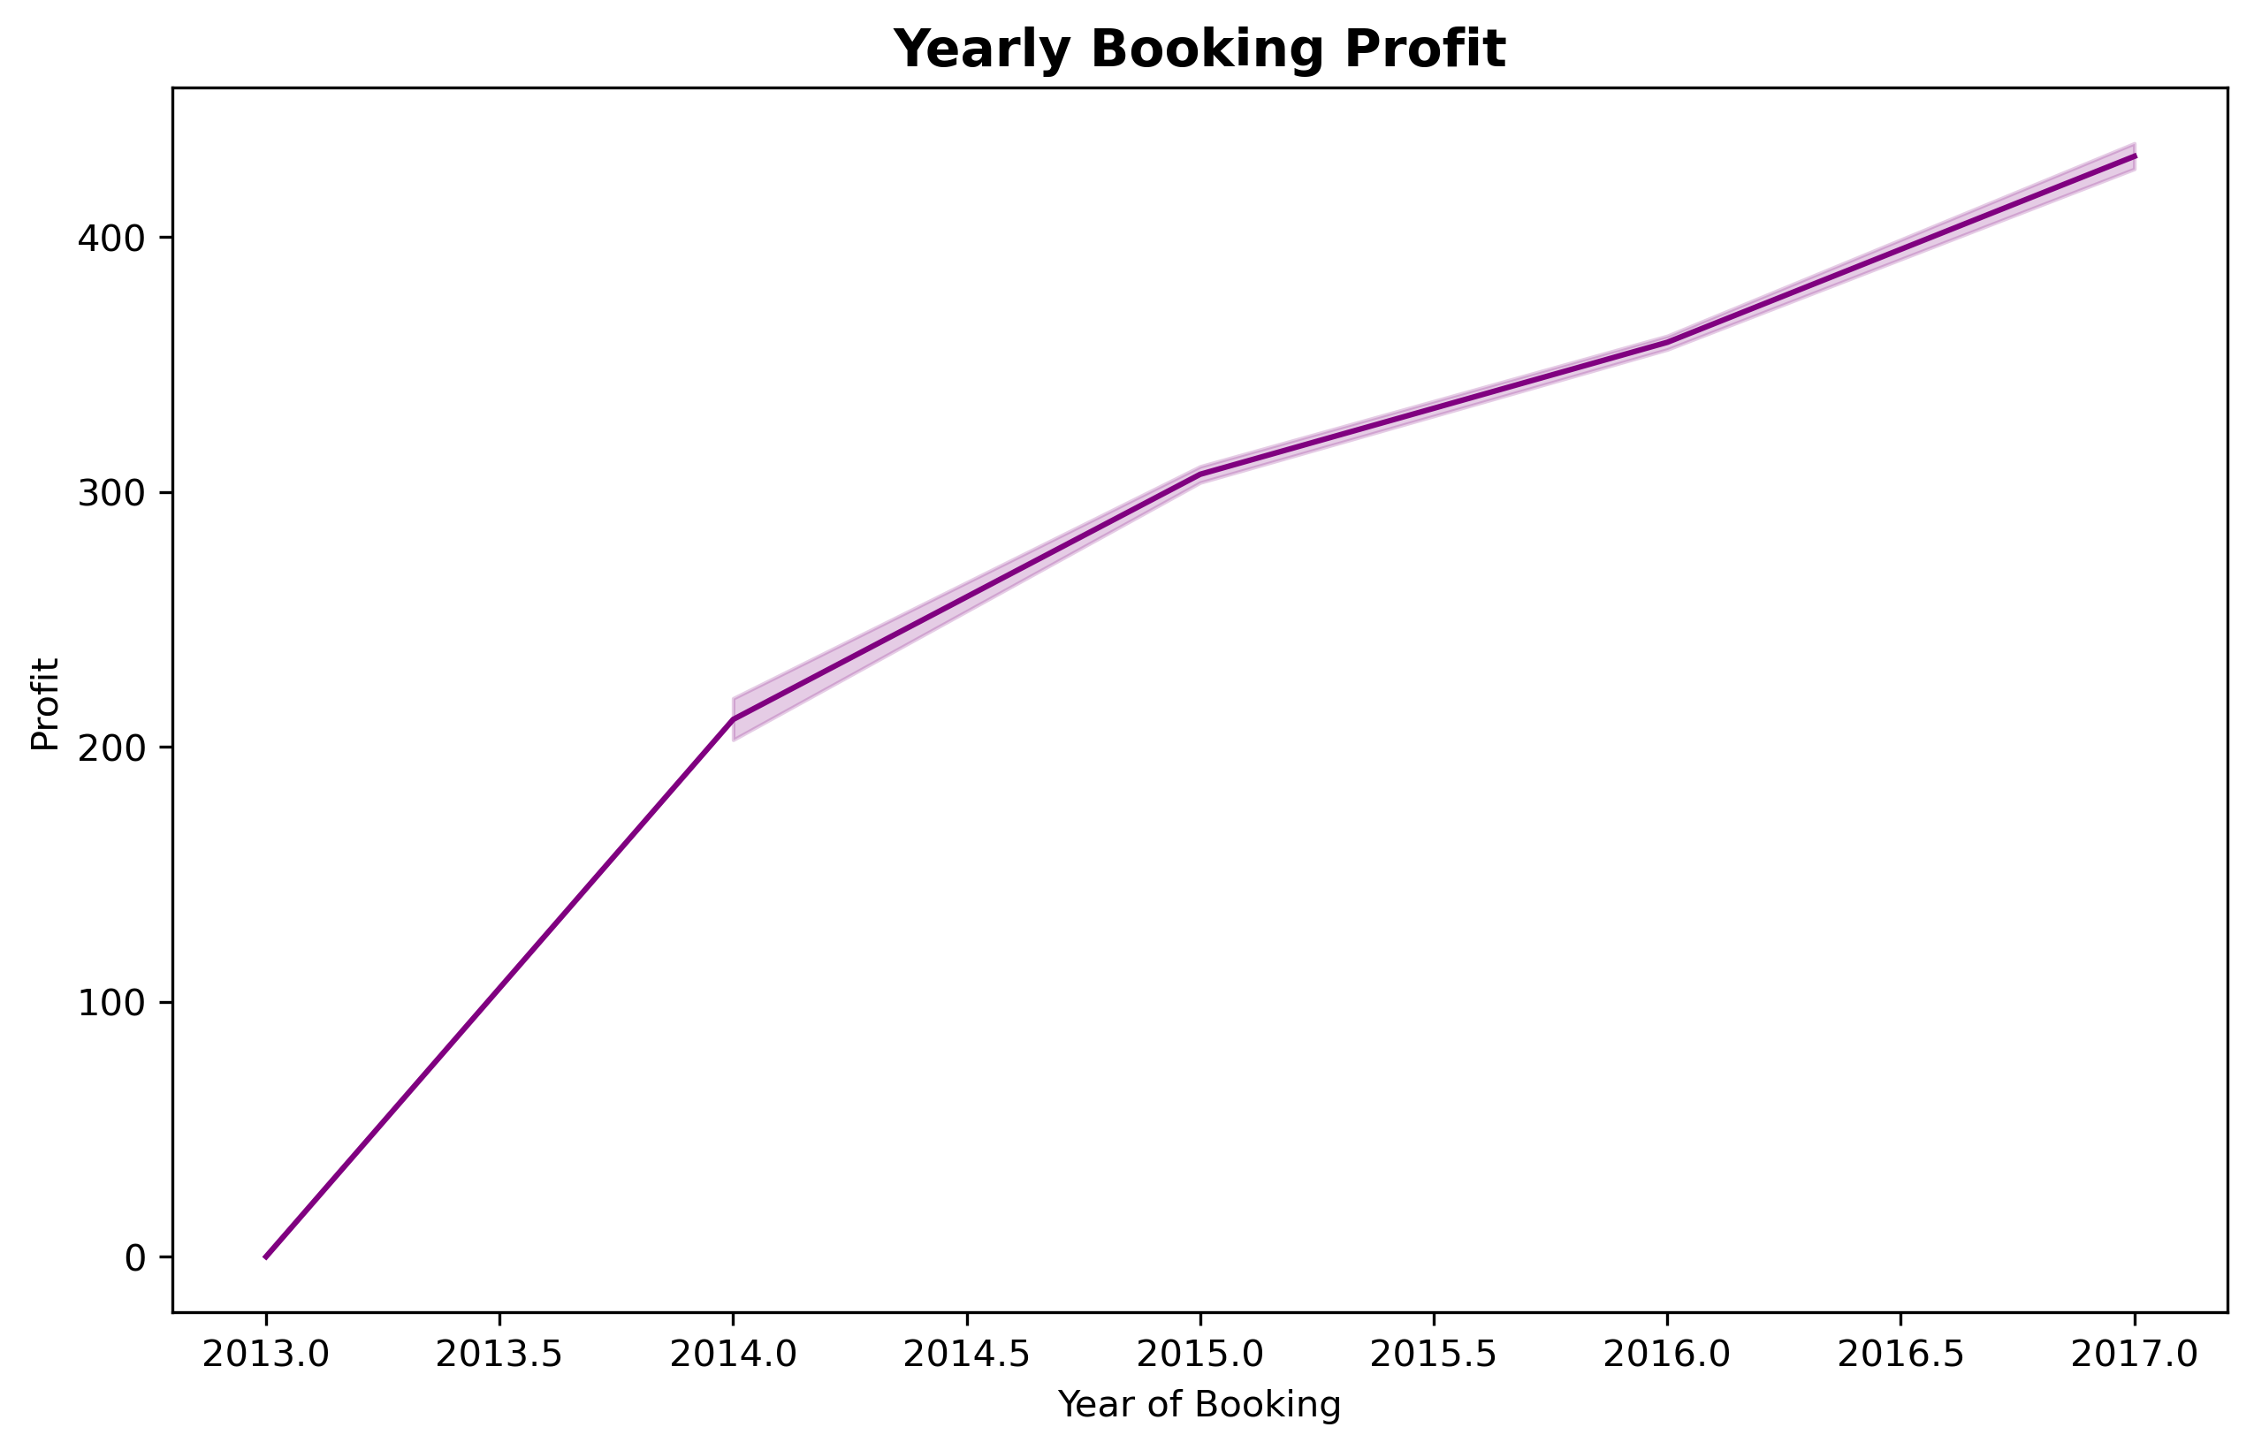
Yearly Revenue vs Profit
Yearly booking revenue and profits steadily grew from 2013 to 2017, with notable growth in 2014 and significant highs by 2017.

Slide 16
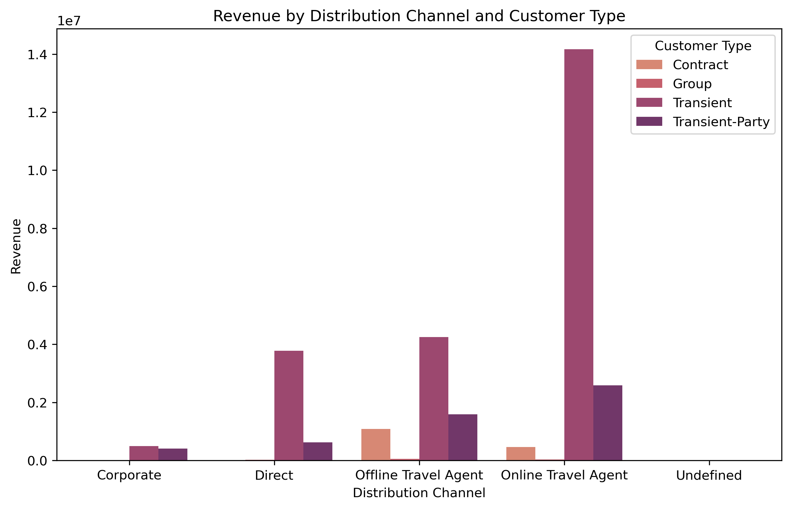
Revenue by Channel and Customer Type
The "Online Travel Agent" channel drives the highest revenue, especially from transient customers.

Slide 17
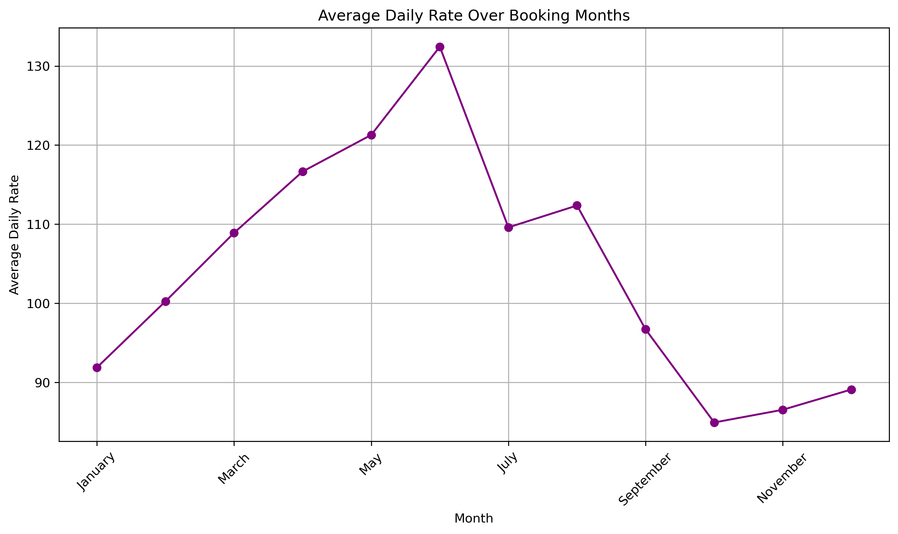
Average Daily Rate by Month
The average daily rate peaks in July, drops steadily until November, and slightly rises toward the year's end.

Slide 18
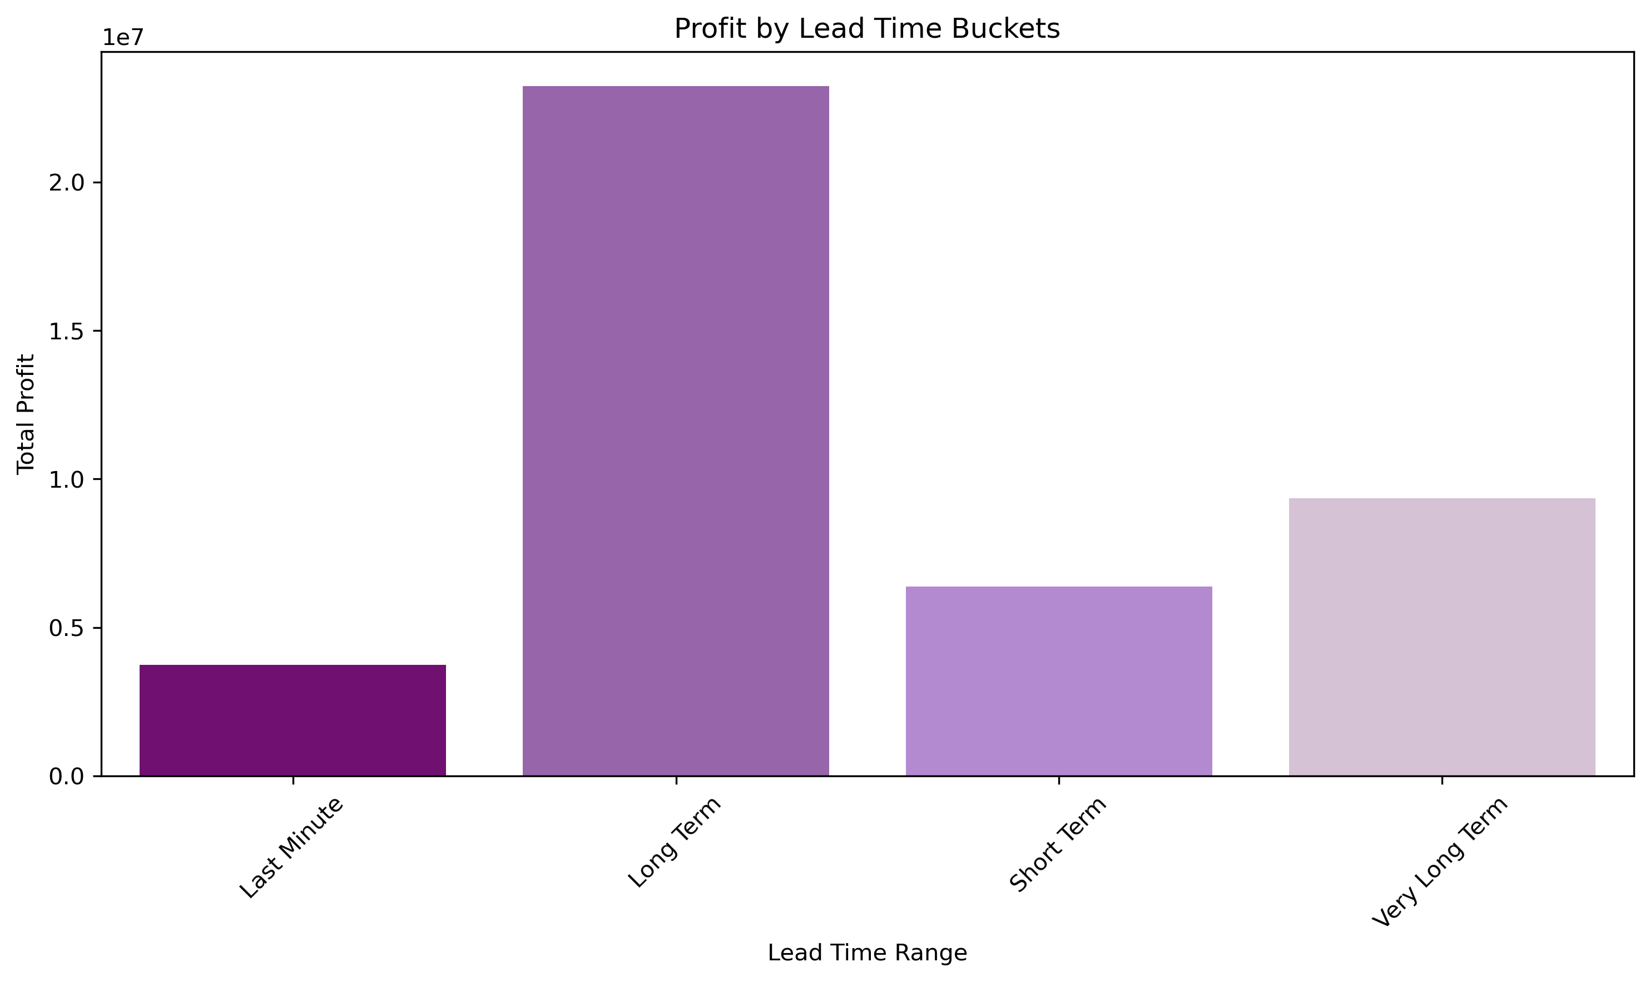
Profit by Booking Window
Bookings with longer lead times bring the most profits, while last-minute bookings yield the least.

Slide 19
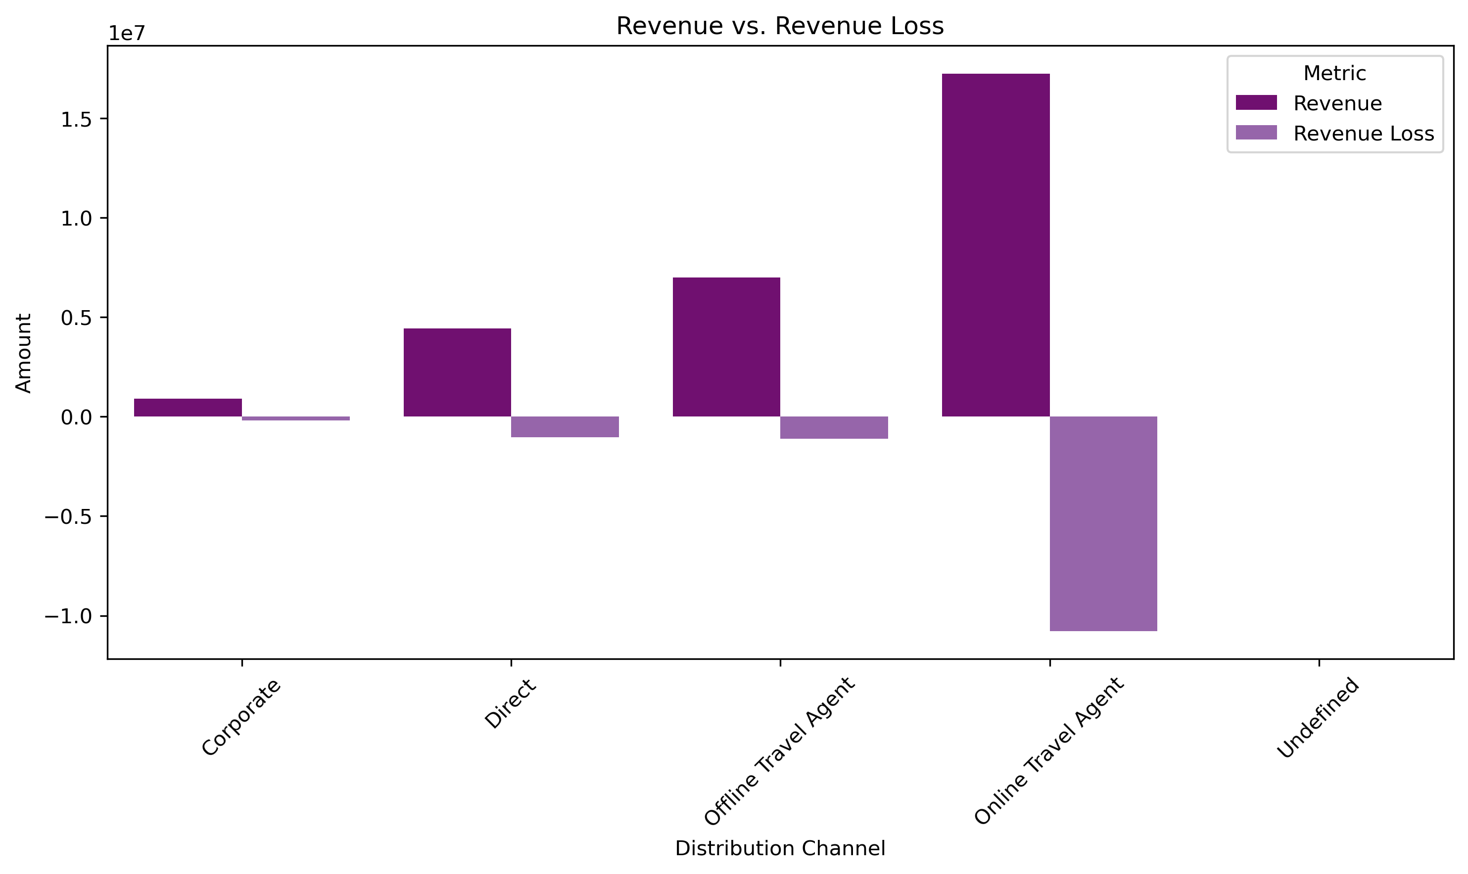
Revenue Gain vs Revenue Loss
The "Online Travel Agent" channel generates the most revenue but also faces significant losses.

Slide 20
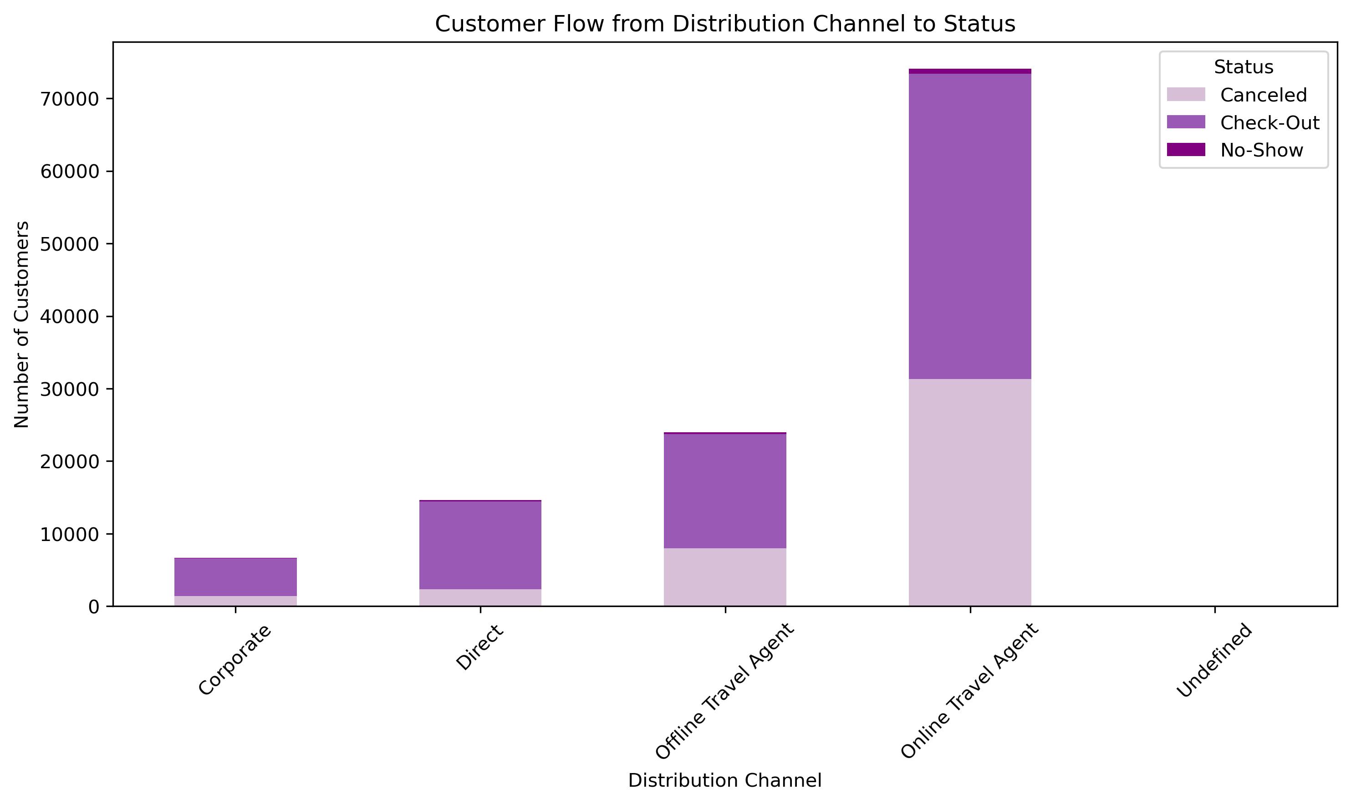
Customer Flow: Distribution Channel to Status
The "Online Travel Agent" channel has the most customers, with successful checkouts being common and fewer cancellations or no-shows.

Slide 21
Findings
Hotel bookings outnumber resorts; transient customers and couples are the main segments.
Online travel agents lead in bookings and revenue but face high cancellations.
Guests book early, prefer short stays, and no-deposit options.
Portugal leads in bookings and revenue; distant countries show low activity.
Peak bookings occur in January-February and summer months.
Daily rates peak in July and dip until November.
Most bookings succeed; no-deposit bookings have higher cancellations.
Revenue and profits grew steadily from 2013 to 2017.
Fridays and Thursdays see the most arrivals.
All guests are first-time visitors, highlighting loyalty opportunities.

Slide 22
Recommendations
Introduce loyalty programs to encourage repeat visits.
Optimize "Online Travel Agent" channel profitability and diversify sources.
Focus marketing on top markets like Portugal, UK, and France.
Leverage seasonal peaks with promotions; attract guests in low-demand periods.
Adjust no-deposit policies to reduce cancellations.
Target transient guests and couples with tailored packages.
Use long-term booking trends for better inventory and pricing strategies.
Maximize peak periods with higher daily rates; offer discounts in low-demand times.
Create weekend deals to boost Friday and Thursday arrivals.
Strengthen digital marketing to maintain online booking dominance.

Slide 23
To wrap up, we’ve uncovered key trends in bookings, customer preferences, and revenue growth. By focusing on loyalty programs, enhancing digital marketing, and optimizing seasonal opportunities, we can boost guest satisfaction and profitability. These insights guide us toward smarter strategies to stay competitive and grow successfully.

Slide 24
Thank You

